Slide 1
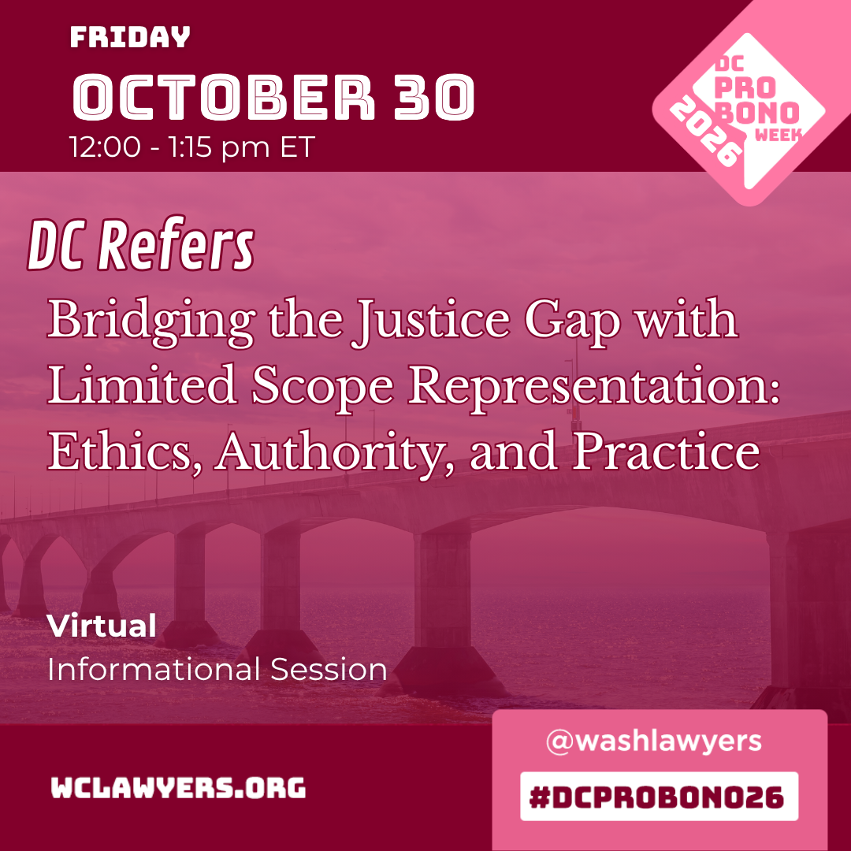

Slide 2

2026
DC REFERS
A NETWORK OF AFFORDABLE
LAWYERS AND MEDIATORS
dcrefers.org

Slide 3
2026
MISSION
DC Refers is a 501(c)(3) nonprofit that connects qualified lawyers and mediators with DC residents who earn too much to qualify for free legal services - but not enough to afford standard rates.
This is the "justice gap": households earning between 200-400% of the federal poverty level.
That's a family of four earning between $66,000 and $132,000 a year. They have real legal needs. They just need an attorney willing to meet them in the middle.

Slide 4
2026
REFERRALS
GOOD FOR YOUR COMMUNITY. GOOD FOR YOUR PRACTICE.
GROW
GIVE BACK
CONNECT
Receive referrals for both reduced-fee and full-fee clients. DC Refers connects you with DC residents actively seeking legal help - no marketing required.
Set your own schedule and case load. You decide how many clients to take and when.
Access ongoing networking, and professional development through DC Refers Reconnect

Slide 5
2026
FEE
STRUCTURE
DC Refers panel attorneys represent modest-means clients at $75–$150/hour or the fixed-fee equivalent — making legal services accessible to the people who need it most.
For clients who don't qualify as modest-means, you may charge your typical market rate or sliding scale.
Modest-means clients are individuals and families earning between 200–400% of the federal poverty level — typically too much for free legal aid, and not enough for standard rates.

Slide 6
2026
Employment
  Contesting non-competes
  Wage theft / Unpaid benefits
  Workplace discrimination
Immigration
  Citizenship
  Deportation
  Family-based visas
Business
  Contracts
  Business formation
  Disputes
PRACTICE
AREAS
Family
  Child support / Child custody
  Guardianship / Adoption & Protection Orders
  Divorce
Landlord/Tenant
  Evictions
  Tenants
  Small landlords
Estates, Wills, & Elder Law
  Wills & trusts
  Guardianship
  Power of attorney
  Probate
Consumer Protection & Debt
  Credit report issues
  Identity theft
  Debt collection
  Contractor disputes
Criminal & Traffic
  Felony/Misdemeanor
  DUI/DWI
  Traffic violations
Home Ownership
  Foreclosure
  Title
  Neighbor disputes
  Property taxes
and more!
Notes:
- Make sure to say this is NOT a comprehensive list of all of the practice areas
- Flag areas in need: LT, employment, consumer

Slide 7
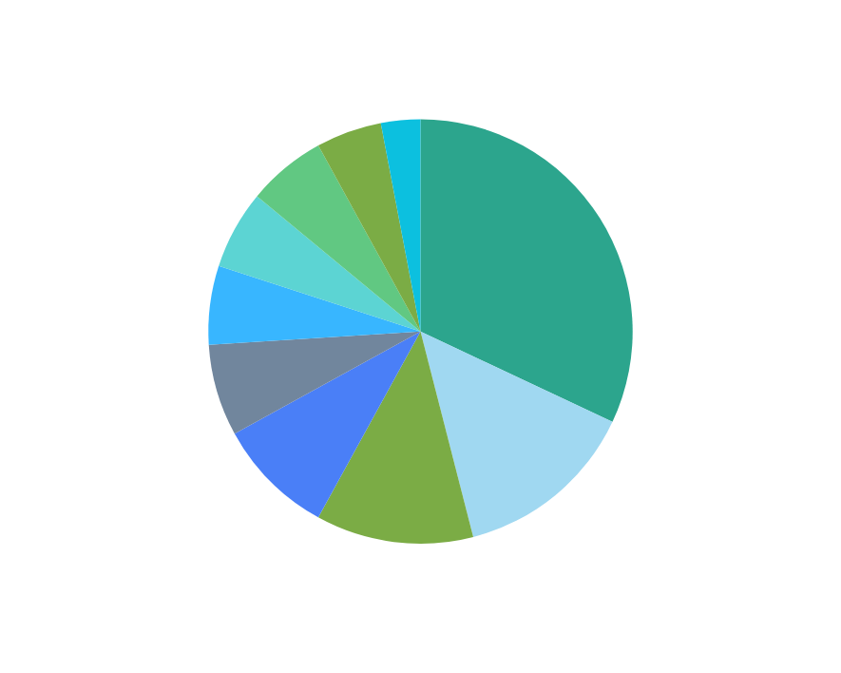
2026
BY THE NUMBERS
5,991 total requests for legal assistance since 2017
2,006 brief advice sessions and consultations provided
505 retained client engagements
2025 alone: 791 requests, 202 consultations, 59 retained matters

Slide 8

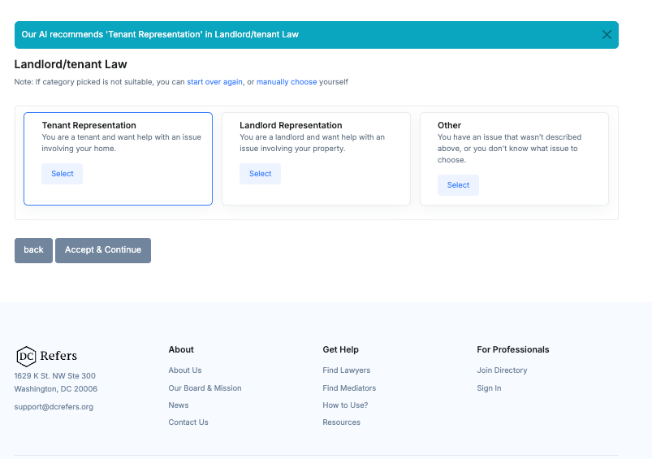
2026
MODERN PLATFORM BUILT FOR ACCESS
Clients can search the DC Refers directory directly at dcrefers.org. Thanks to a $15,000 American Bar Endowment grant, we have an AI-assisted search feature that helps clients describe their issue in plain language and get matched with the right attorney faster.

Slide 9
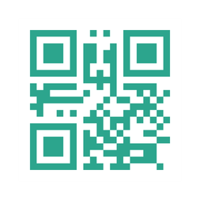
2026
READY TO APPLY?
DCREFERS.ORG
The application process is simple and straightforward.
Why attorneys join:
Meaningful experience in the practice areas in which you intend to be listed | Proof of liability insurance ($100,000/$300,000)
Resume and proposed fee schedule | Two professional references and two client references
Bar number and good standing | $50 non-refundable application fee
Give back to the DC community by serving clients who genuinely need your help
Build your practice with a steady pipeline of referred clients
Expand your network within DC's legal community
Take on as much or as little as fits your schedule - no quotas, no minimums
Notes:
Speaker notes if there are questions:
- Timeline - anywhere from 1-6 months. Longer end of range is typically due to issues/delays with reference scheduling
- Reporting requirements if admitted

Slide 10
2026
¡THANK YOU!
dcrefers.org
support@dcrefers.org

